Slide 1
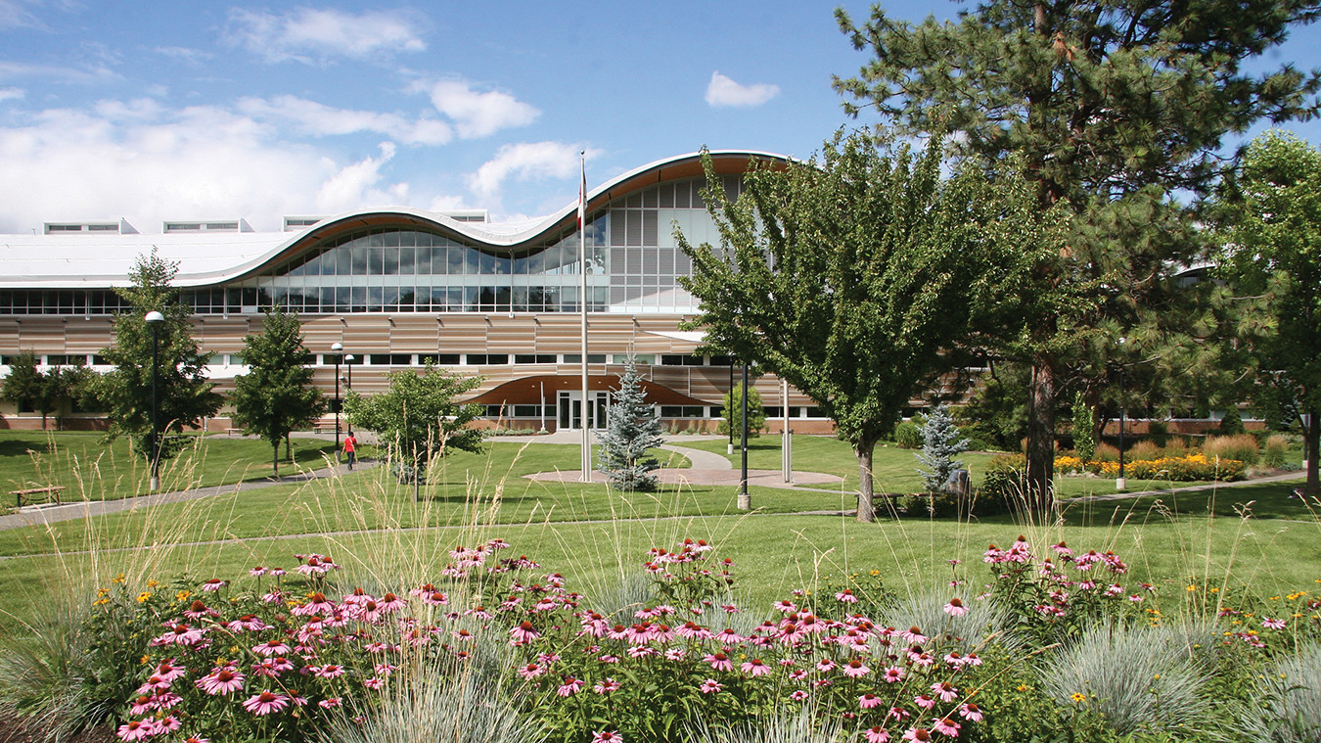

Co-op Student Handbook
Career and Experiential Learning

Slide 2

What is Co-op education
Integrates a student’s academic studies with leaning in a workplace or practice setting.
Allows students to substitute an academic semester with working a paid job relevant to their studies.
Work terms are either 4, 8, or 12 months long.
Helps develop learning outcomes related to employability, personal agency, and lifelong learning.

Slide 3

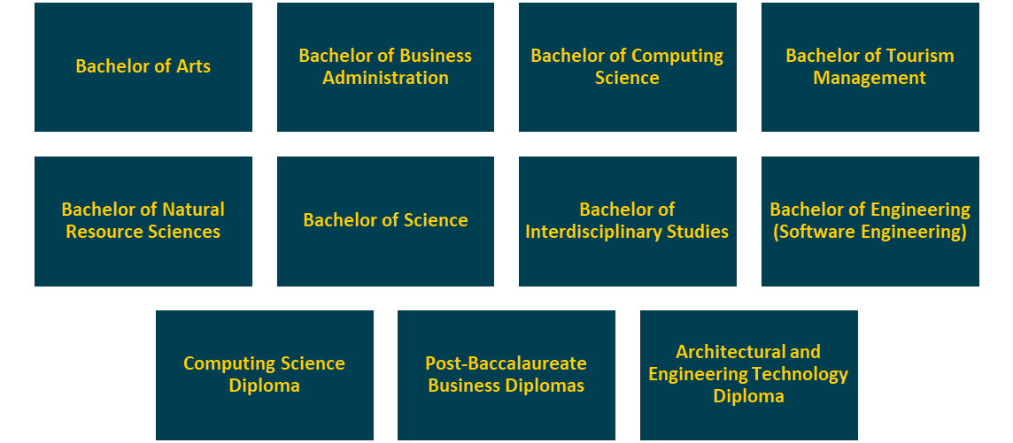
What Programs are Offered

Slide 4

Steps Prior to a Work Term
Take the Co-op 1000 class and pass.
Make sure your resume and interview skills are well developed.
Consult with your Co-op Coordinator about potential employment opportunities and strategies.

Slide 5
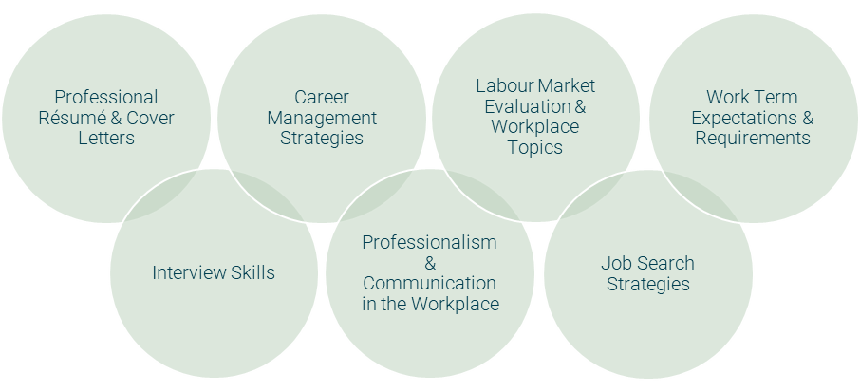

What You Will Learn in Co-op 1000

Slide 6

Maximizing Opportunities in Co-op
Students must compete for securing employment. TRU does not guarantee employment.
Make sure your resume and interview skills are prepared and effectively developed.
Create and understand experience goals and abilities to improve on during your work experience.
Book meetings with your Co-op Coordinator to help identify goals and career development.

Slide 7

How to Successfully Complete Your Work Term
Obtain a paid work term (420 Hours/Semester)
Pay the TRU tuition costs for that term.
Complete all roles and objectives outlined by your employer.
Complete all online Moodle course material for that work term.
Complete and submit Employer Evaluation once Work Term is completed.

Slide 8

Continuation and Withdrawal
The Co-op program has a one-time admission and withdrawal policy. If a student withdrawals from the program, they cannot re-apply.
It’s the Students responsibility to maintain contact with career advisors and check job postings.
It's expected to accept a job offer within 24 hours of receiving it.
Students must maintain and update their Career Connections account per semester.
Students cannot end their academic program on a work term.

