Slide 1
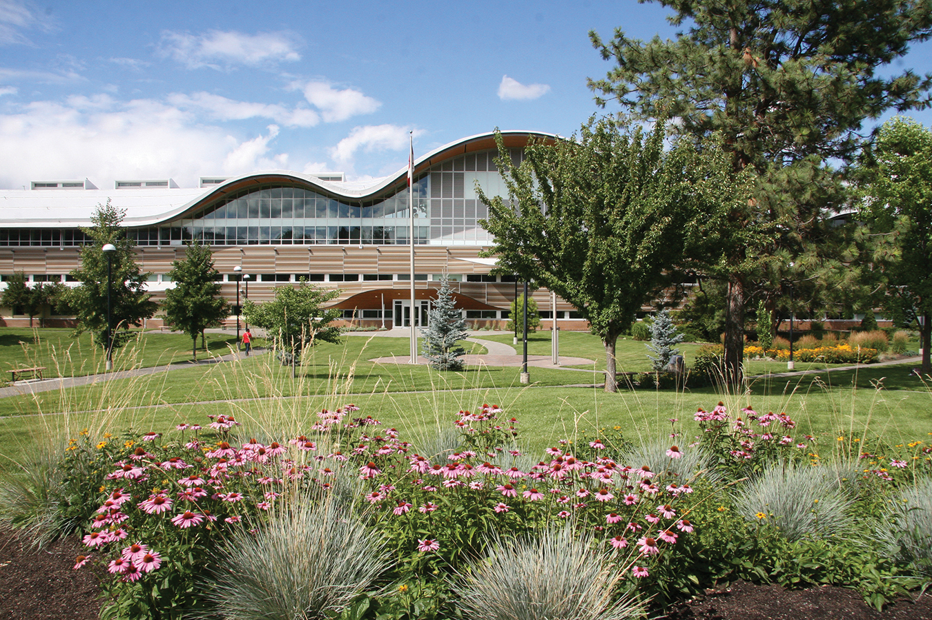

Co-operative Education
Info Session
Summer 2024 Co-op
Computing Science, Software Engineering

Slide 2
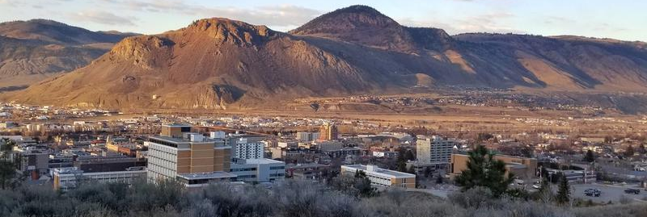
Territorial Acknowledgement
Thompson Rivers University campuses are on the traditional lands of the Tk’emlúps te Secwépemc within Secwépemc’ulucw, the unceded territory of the Secwépemc.

Slide 3
Agenda
Dates and deadlines
Communication and new website
Expectations, rules, and regulations
Events
Supports available
Set yourself up for success

Slide 4
Meet Your Coordinators
Leanne Mihalicz
lmihalicz@tru.ca
Rashmin Keshwani
rkeshwani@tru.ca
Program Assistant
Nicolas Bosworth
It_cooped@tru.ca

Slide 5
Dates and Deadlines
May 1 is a common first day for a summer work term but for some employers you may start as soon as your Winter 2024 exams are completed, or you may not start until the middle of May.
The add/drop date is the last day we can enroll students in a summer work term (May 17, 2024) so this means you can search for a summer work term until May 17th.

Slide 6
Communication
Career Connections​:
  Job posting events​
  Schedule one-on one appointments​
  Update Work term notification​
Drop-in sessions ​- Weekly in-person on Fridays 10 to 11 am (OM 1802)​
Email​
  Check your email – this is the main way we will let you know about upcoming interview requests, last-minute job postings, events, and other important information​
Technology Resource website! Link​

Slide 7
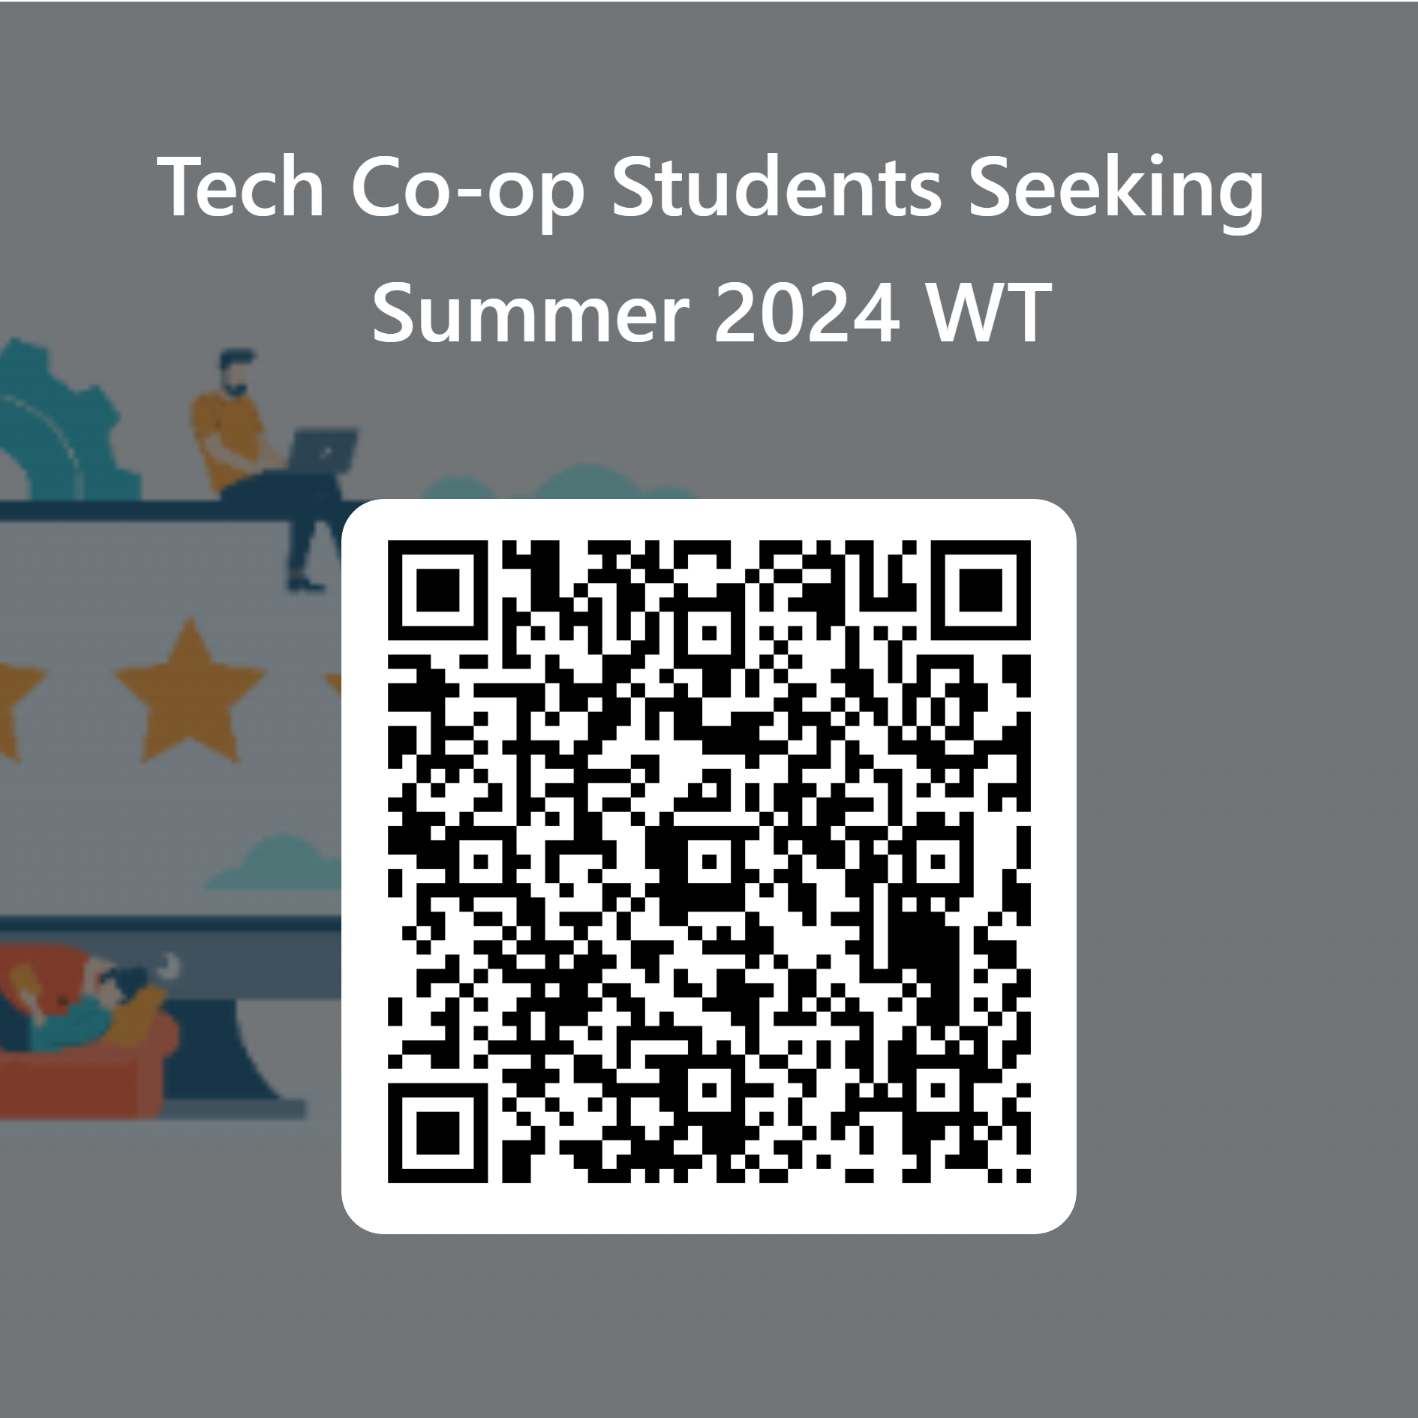
Complete questionnaire (Microsoft Form QR code OR link in chat)
Notes:
https://forms.office.com/r/k0PdiRJKsH

Slide 8

Acquiring Credit for Co-op?
All co-op work terms are for credit
Each program is different in how many credits are granted toward degree
Computing Science (both for bachelor and diploma program)
  First 6 credits – lower elective
  3rd work term – 3 upper CS electives
Software Engineering Bachelor program
  6 credits for mandatory co-op (after 3rd year)
  Additional co-ops are additive credits

Slide 9

Max # of Co-ops and Designation
Bachelor program:
Domestic – max. 5 co-op work terms
International – max. 4 co-op work terms
Diploma program
Domestic – max. 4 co-op work terms
International – max. 3 co-op work terms
Designation of degree:
Bachelor program – 3 co-op work terms
Diploma program – 2 co-op work terms

Slide 10
Getting Started
Networking leads to 70% of co-op job offers. The more you network, the better chances of getting a job offer.
Informational Interviews are still the best way to really get to know employers.
Attending networking events at the Kamloops Chamber of Commerce, TRU Job Fair on Feb 1st, and other recruitment events will lead to a strong possibility of a job offer.

Slide 11
Searching Online
Career Connections
LinkedIn
Indeed
Glassdoor
BCJobs
Worxica
Wow Jobs
Company Websites
News articles
Associations
Intern Insider – student created
https://www.interninsider.me/subscribe?ref=Cf4uk9phsZ

Slide 12
Data Analyst Intern
Klue 5 - Vancouver, BC
Hybrid remote
Agile Support Office Co-op/Internship (Summer 2024)
British Columbia Investment Management Corporation (BCI) - Victoria, BC
Hybrid remote
Technology Specialist Co-op/Internship (Summer 2024)
British Columbia Investment Management Corporation (BCI) - Victoria, BC
Hybrid remote

Slide 13
Featured Jobs in CC
 | CEWIL, digital marketing
Tech Coal | Urban Systems
Amazon , Vancouver | Smith and Anderson
Quality Control Operations Co-op Student | Stem Cell Technologies (Vancouver, BC)
Data Engineer Intern/Co-op SU24 | Olympic Industries ULC (North Vancouver, BC)
Co-op Student - Computer/Electrical Engineer-SU 2024 HYBRID | BC Hydro
Full Stack Developer (Co-op) Richmond | Lucid Vision Labs
Web Development Co-op (Vancouver) HYBRID SU24 | BGC Engineering (Vancouver, BC)
73 jobs with deadline to apply on 15th Jan for Summer Positions.
Jobs for SU 24

Slide 14
Top 50 Companies in BC
Teck Resources Limited | Apera AI
Hootsuite | ICBC
Thinkific Labs | Clio
Alida Inc | BCLC
Ausenco Engineering | SAP
BC Hydro | TELUS Communications Inc
BC Public Service | Lucid Vision Labs
Binary Stream Software | Interior Health
​
https://canadastop100.com/bc/

Slide 15
Events
Job Fair Feb 1st 10-3pm – Campus Activity Centre
Get Your Resume Ready Workshop
Jan 24 1:30 pm Virtual rsvp in CC
How to Prepare for Job Fair
Jan 25 1-2pm OM 1762
LinkedIn Personal Branding
Jan 26, 1 pm OM 2662
Enterprise Info Session & Mock Interview Workshop
Jan 31st 12 to 2 Grand Hall
Employer Info Sessions
Northern Development Initiative Trust – Jan 23 1 pm
Rocky Mountaineer (Kamloops, BC)- Jan 19, 1 pm
BCLC – Business Technology Summer Co-op - Jan 26, 10 am TRUSU Lecture Hall

Slide 16
Prepare and plan prior to your appointments with Coordinator
Identify (research companies) 6 to 10 companies you want to apply to
Save postings for future reference
Create a Job Search tracking systems (Excel, Word, etc.)
Update resume and learn to customize

Slide 17

Application Tips
Do your research
Customize to the posting
Showcase why you want to work for company and what you have to offer
Include cover letter if possible
Have others review your documents
Reach to people who work there

Slide 18
Interviewing
CEL Mock Interviews
Interview practice with Coordinators or even employers
Do you know your top 3 assets/skills? Are these showcased in resume?
Develop your stories - Use Star method
Be able to answer why you should be hired and why you want to work for company
Have some great questions prepared for employer

Slide 19
I Got an Offer, Now What?
Students are expected to accept a job offer immediately within 24 hours of receiving it. This includes both verbal and written offers.
If you have any confusion with the job offer reach out to your co-op coordinator to discuss it.
Students will not apply for further co-op jobs after accepting a job offer.
Send the signed offer letter to your co-op coordinator and the co-op program assistant at it_cooped@tru.ca
After receiving the signed offer letter, the co-op program assistant will send you an email to follow the steps for co-op work term course registration.

Slide 20
Job Search Wellness
Take breaks from job searching
Be Aware of Social Media Blues
Don't compare yourself to others
Reach out to supports
(other students, coordinators, family/friends, counselling)
Try to make your health a priority (activity, diet, sleep, etc.)

Slide 21

Questions
What are recruiters and employers looking for?

Slide 22





Career & Experiential Learning
tru.ca/cel
Phone: (250) 371-5628
Address: OM 1712
TRU Career and Experiential Learning
TRU Career & Experiential Learning
It_cooped@tru.ca

